Slide 1
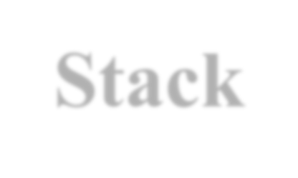
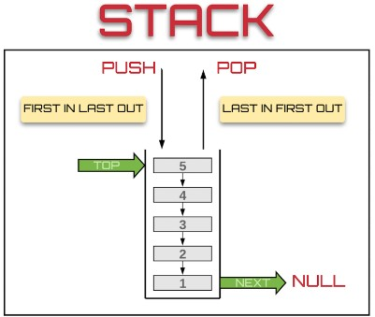
Stack
Stack is a linear data structure which follows a particular order in which the operations are performed.
Insertion of element into stack is called PUSH and deletion of element from stack is called POP.
The order may be LIFO(Last In First Out) or FILO(First In Last Out).

Slide 2

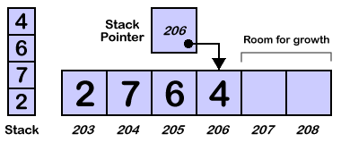
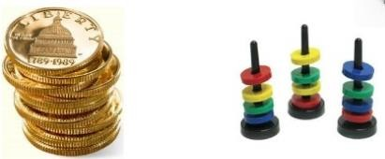
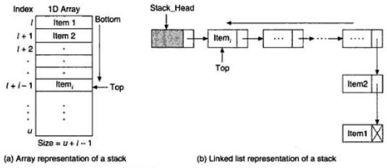
Representation of Stack in Memory
The stack can be implemented into two ways:
Using arrays (Static implementation)
Using pointer (Dynamic implementation)

Slide 3
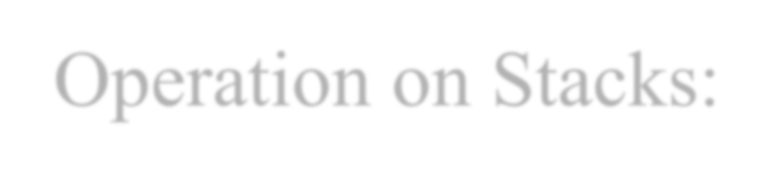
Operation on Stacks:
Stack( ): It creates a new stack that is empty. It needs no parameter and returns an empty stack.
push(item): It adds a new item to the top of the stack.
pop( ): It removes the top item from the stack.
isEmpty( ): It tests whether the stack is empty.
size( ): It returns the number of items on the stack.

Slide 4
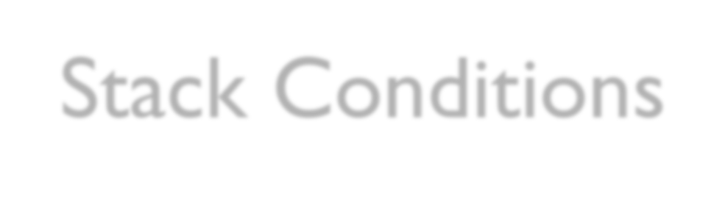
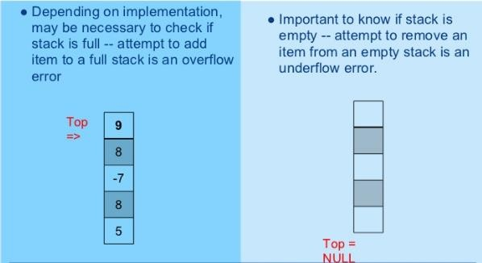
Stack Conditions

Slide 5

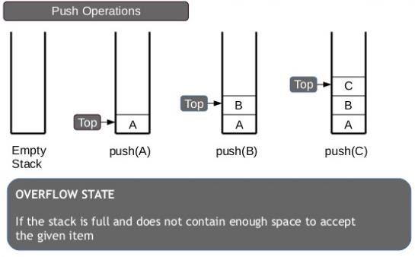
PUSH Operation
The process of adding one element or item to the stack is represented by an operation called as the PUSH operation.

Slide 6

PUSH Operation:
The process of adding one element or item to the stack is represented by an operation called as the PUSH operation.
The new element is added at the topmost position of the stack.
ALGORITHM:
PUSH (STACK, TOP, SIZE, ITEM)
STACK is the array with N elements. TOP is the pointer to the top of the element of the array. ITEM to be inserted.
Step 1: if TOP = N then [Check Overflow]
PRINT “ STACK is Full or Overflow”
Exit
[End if]
Step 2: TOP = TOP + 1
Step 3: STACK[TOP] = ITEM
Step 4: Return
[Increment the TOP]
[Insert the ITEM]

Slide 7

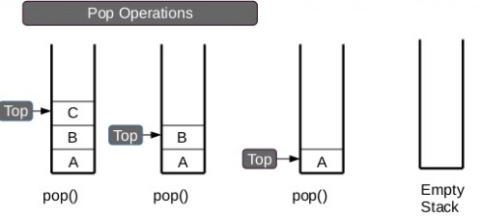
POP Operation
The process of deleting one element or item from the stack is represented by an operation called as the POP operation.
When elements are removed continuously from a stack, it shrinks at same end i.e., top

Slide 8
POP Operation
The process of deleting one element or item from the stack is represented by an operation called as the POP operation.
ALGORITHM: POP (STACK, TOP, ITEM)
STACK is the array with N elements. TOP is the pointer to the top of the element of the array. ITEM to be inserted.
Step 1: if TOP = 0 then [Check Underflow] PRINT “ STACK is Empty or Underflow”
Exit [End if]
Step 2: ITEM = STACK[TOP] Step 3: TOP = TOP - 1
Step 4: Return
[copy the TOP Element] [Decrement the TOP]

Slide 9

Application of Stacks
It is used to reverse a word. You push a given word to stack
– letter by letter and then pop letter from the stack.
“Undo” mechanism in text editor.
Backtracking: This is a process when you need to access the most recent data element in a series of elements. Once you reach a dead end, you must backtrack.
Language Processing: Compiler’ syntax check for matching braces in implemented by using stack.
Conversion of decimal number to binary.
To solve tower of Hanoi.
Conversion of infix expression into prefix and postfix.
Quick sort
⚫ Runtime memory management.

Slide 10

Queue
A queue is an ordered collection of items where an item is inserted at one end called the “rear” and an existing item is removed at the other end, called the “front”.
Queue is also called as FIFO list i.e. First-In First- Out.
In the queue only two operations are allowed enqueue and dequeue.
Enqueue means to insert an item into back of the queue.
Dequeue means removing the front item.The people standing in a railway reservation row are an example of queue.
Prof. K. Ad
48

Slide 11

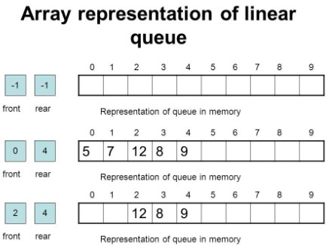
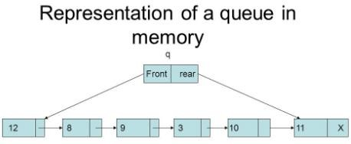
Queue
The queue can be implemented into two ways:
Using arrays (Static implementation)
Using pointer (Dynamic implementation)
49
Prof. K. Ad

Slide 12

Types of Queues
Queue can be of four types: o Simple Queue
Circular Queue
Priority Queue
De-queue ( Double Ended Queue)

Slide 13

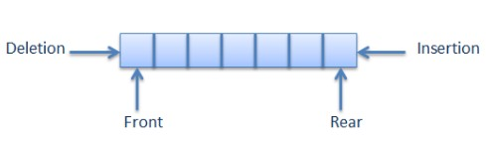
Simple Queue
Simple Queue: In simple queue insertion occurs at the rear end of the list and deletion occurs at the front end of the list.

Slide 14

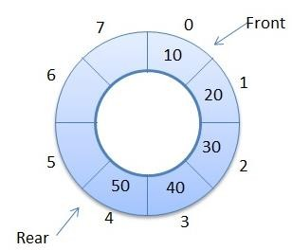
Circular Queue
Circular Queue: A circular queue is a queue in which all nodes are treated as circular such that the last node follows the first node.

Slide 15

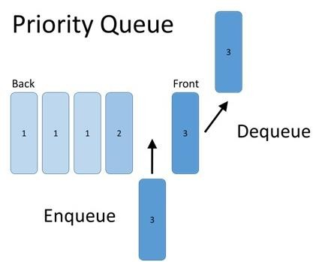
Priority Queue
A priority queue is a queue that contains items that have some present priority. An element can be inserted or removed from any position depending upon some priority.

Slide 16

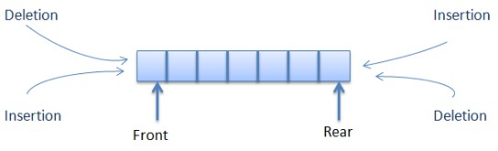
Dequeue Queue
Dequeue: It is a queue in which insertion and deletion takes place at the both ends.

Slide 17

Operation on Queues
Queue( ): It creates a new queue that is empty.
enqueue(item): It adds a new item to the rear of the queue.
dequeue( ): It removes the front item from the queue.
isEmpty( ): It tests to see whether the queue is empty.
size( ): It returns the number of items in the queue.

Slide 18
Memory Representation of a queue using array
Queue is represented in memory using linear array.
Let QUEUE is a array, two pointer variables called FRONT and REAR are maintained.
The pointer variable FRONT contains the location of the element to be removed or deleted.
The pointer variable REAR contains location of the last
element inserted.
The condition FRONT = NULL indicates that queue is
empty.
The condition REAR = N-1 indicates that queue is full.

Slide 19
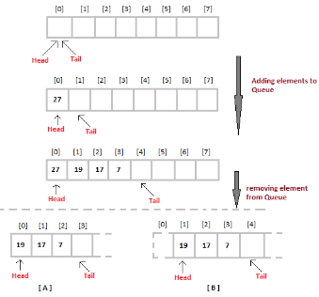
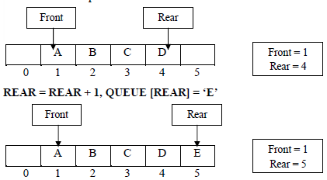
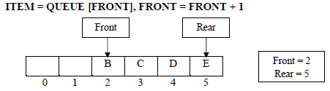
Memory Representation of a queue using array

Slide 20



Queue Insertion Operation (ENQUEUE):
ALGORITHM: ENQUEUE (QUEUE, REAR, FRONT, ITEM)
QUEUE is the array with N elements. FRONT is the pointer that contains the location of the element to be deleted and REAR contains the location of the inserted element. ITEM is the element to be inserted.
Step 1: if REAR = N-1 then [Check Overflow]
PRINT “QUEUE is Full or Overflow”
Exit
[End if]
Step 2: if FRONT = NULL then [Check Whether Queue is empty] FRONT = -1
REAR = -1
else
REAR = REAR + 1 [Increment REAR Pointer]
Step 3: QUEUE[REAR] = ITEM [Copy ITEM to REAR position]

Slide 21

Queue Deletion Operation (DEQUEUE)
ALGORITHM: DEQUEUE (QUEUE, REAR, FRONT, ITEM)
QUEUE is the array with N elements. FRONT is the pointer that contains the location of the element to be deleted and REAR contains the location of the inserted element. ITEM is the element to be inserted.
Step 1: if FRONT = NULL then [Check Whether Queue is empty] PRINT “QUEUE is Empty or Underflow”
Exit [End if]
Step 2: ITEM = QUEUE[FRONT]
Step 3: if FRONT = REAR then [if QUEUE has only one element] FRONT = NULL
REAR = NULL
else
FRONT = FRONT + 1 [Increment FRONT pointer]

Slide 22

Application of Queue
Simulation
Various features of Operating system
Multi-programming platform systems.
Different types of scheduling algorithms
Round robin technique algorithms
Printer server routines
Various application software’s is also based on queue data structure.

Slide 23
Greedy Algorithm
Suppose that a problem can be solved by a sequence of decisions. The greedy method has that each decision is locally optimal. These locally optimal solutions will finally add up to a globally optimal solution.
A greedy algorithm works in phases. At each phase:
You take the best you can get right now, without regard for future consequences
You hope that by choosing a local optimum at each step, you will end up at a global optimum

Slide 24
An simple example
Problem: Pick k numbers out of n numbers such that the sum of these k numbers is the largest.
Algorithm:
FOR i = 1 to k
pick out the largest number and
delete this number from the input.
ENDFOR

